Slide 1
Replication for What Drives the Size and Value Factors
Jianan Lin: Coding+ Analysis
Junpeng Li: Checking + Analysis+ Write Up
13/5/2023

Slide 2
CONTENTS
1
Introduction
2
Replication for tables
3
Our extension in hedging
4
Conclusion

Slide 3
Introduction
ONE
1

Slide 4
Topic and Data
In this final project, my group mate and I chose the own topic: replicate the tables and figures in the paper ‘What Drives the Size and Value Factors?’ with the data from Shenzhen Stock Exchange, China. We also did some changes and innovation after the replication. The purpose for this project is to see whether the same conclusion can work for China A-share market.

Slide 5
Content of the paper
This paper mainly research the debate about whether size and value factors capture economic risk. Author found that a large fraction of price fluctuations in the Fama-French size and value factors are non-fundamental price pressures driven by correlated fund flows. These large demand-driven price movements revert over time, explaining approximately 30% of overall factor price fluctuations. Further corroborating the price pressure interpretation, these demand-driven price effects happen exclusively in periods when mutual funds place trades. Overall, his findings imply that a sizeable fraction of factor movements do not represent fundamental risk.

Slide 6
Replication of tables and figures
TWO
2

Slide 7
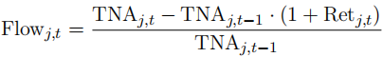
Table 1 Summary Statistics of Mutual Funds.
First we replicate the table 1 in order to summarize the statistics of mutual funds. But before that, there are several indicators that are used to analysis in here.
The flow funds are calculated as
where Retj,t is the post-fee return of fund j in quarter t and TNAj,t is total net assets at the end of quarter t.

Slide 8
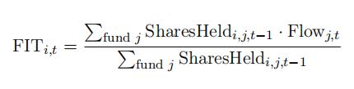
Table 1
The flow funds indicator is used in flow-induced trading (FIT), which is defined as the non-discretionary, stock-level trading induced by fund managers proportionally expanding or contracting their existing holdings in response to fund flows (Lou, 2012).
And the stock-level Flow-Induced Trading (FIT) for each stock i in each quarter t as
where SharesHeldi,j,t−1 is the split-adjusted number of shares of stock i held by fund j at the end of quarter t − 1.

Slide 9
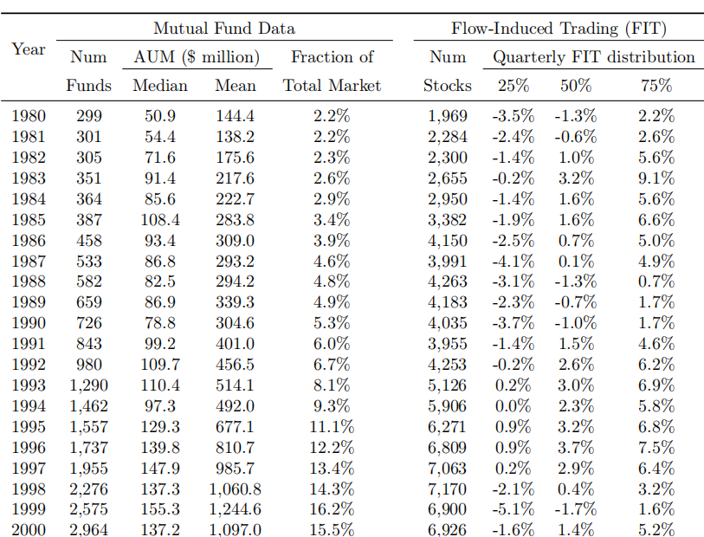
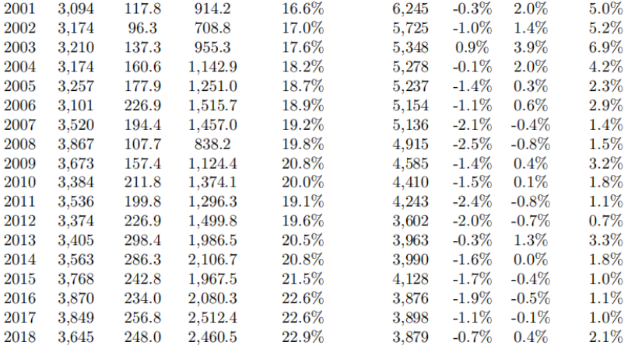
Table 1 (Original)

Slide 10
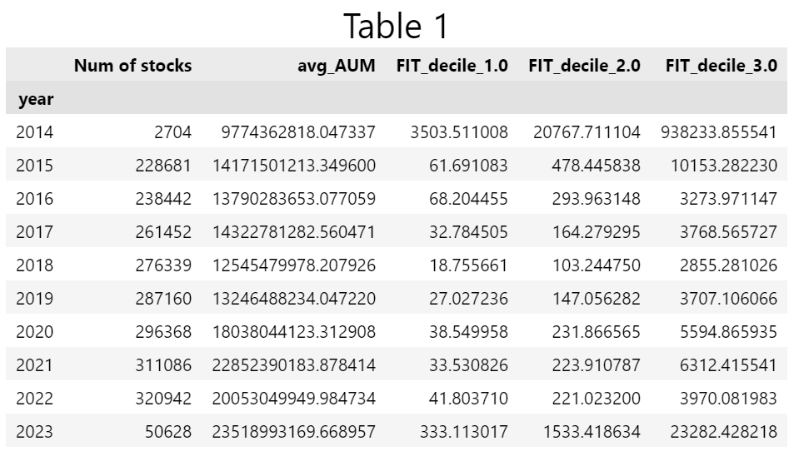
Table 1 (Our replication)
Due to the article, we calculate the FIT data and split them into three decile.
The reason that number of stock in 2014 and 2023 is relatively smaller than remaining years too much is because there are too many data that are not complete and we had to filter them in the raw data.

Slide 11

Difference between Two Tables
What’s more, the FIT distribution table we replicated is not the same as original since there are exact numbers under each decile each year instead of a percentage. This is because author seems ignore the PSF factor in the original paper, which leads to the calculation difference.

Slide 12
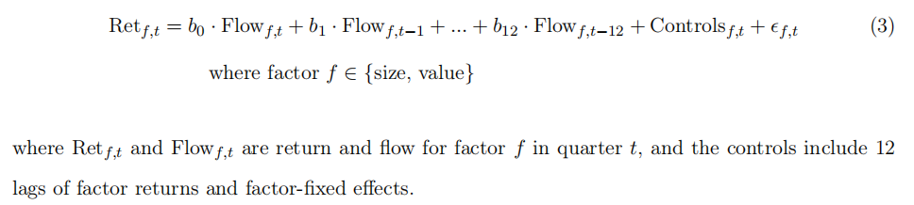
Table 2 (Dynamic Relationship between Factor Flow and Return)
Next we replicate the table 2, for which it is the dynamic relationship between factor flow and the return. Following the similar idea as the original table, we estimate panel regressions of quarterly factor returns on contemporaneous and twelve lags of factor flows by the following equation:

Slide 13
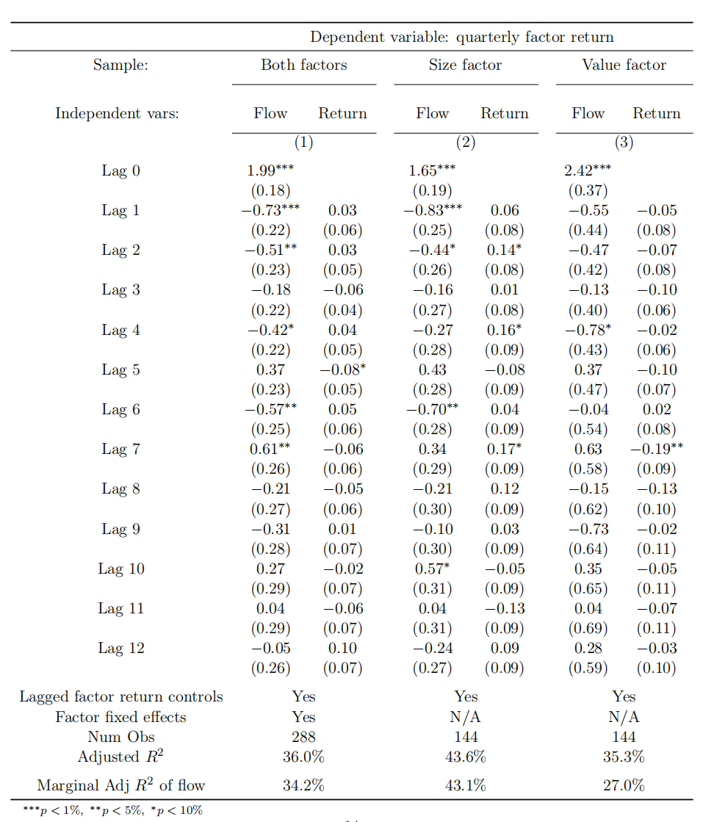
Table 2 (Original)
In this table, author decide to use size and/or value factors by using the market capitalization and the book/market ratio. On the last row of the table, the marginal R2 of flow is estimated as the difference in adjusted regression R-square with or without flow variables. Coefficients statistically significant at the 1%, 5%, and 10% levels are denoted with ∗ ∗ ∗, ∗∗, and ∗, respectively

Slide 14
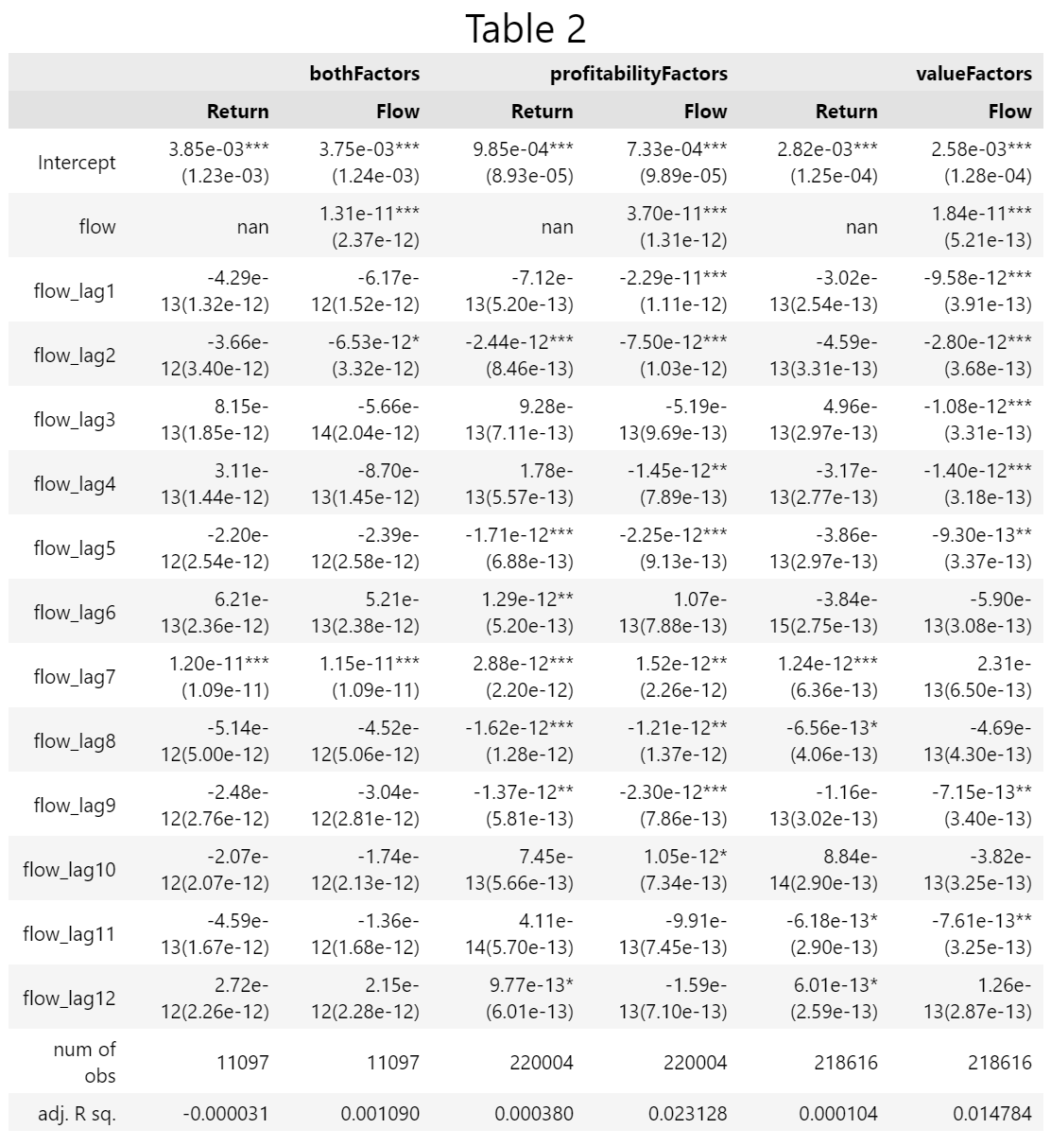
Table 2 (Our replication)
In our replication, instead of estimated on the size and/or value factors, we use the profitability factor (PE ratio/PS ratio) and/or the value factor (PB ratio) instead.

Slide 15
Difference between Two Tables
As shown above, in our replication we have a larger number of observations. However, the values in return, flow and the adjusted R-square are lower than the original paper. In another word, our table performs worse than the original table.

Slide 16
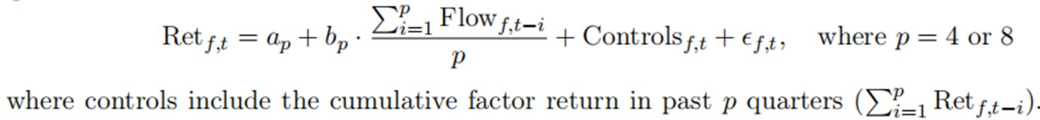

Table 3 (Factor Return Predictability)
After that we replicate the table 3, which use the regressions to predict the quarterly factor returns using lagged flows over past quarters.

Slide 17
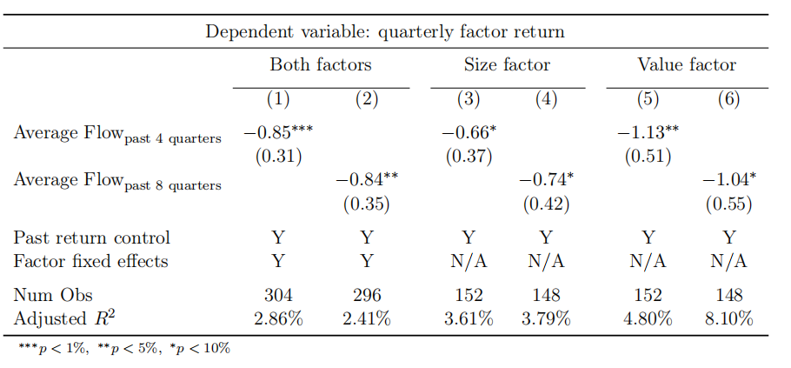
Table 3 (Original)
Similar to table 2, the original table3 here also use the size factor and/or the value factor.

Slide 18
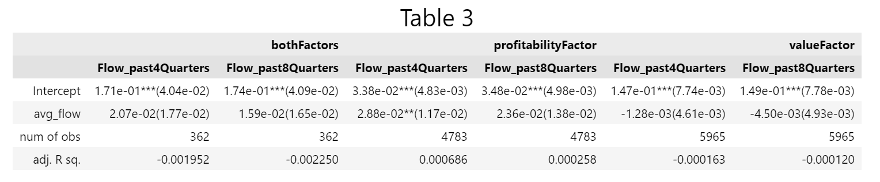
Table 3 (Our replication) and comparison
In our replication, we use the profitability and value factor instead. We have a larger number of observations and average flow for past 4 quarters and past 8 quarters than original replication. However, the adjusted R square is smaller in our replication than the original tables. Both of the factors might not suitable for A-share market

Slide 19
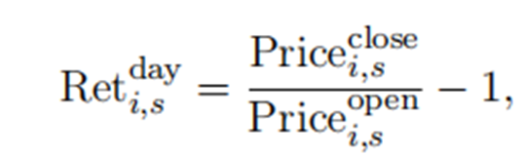
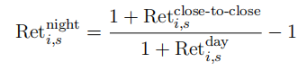
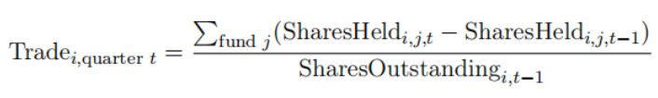

Table 4 (The Effect of Mutual Fund Trades on Intraday and Overnight Returns.)
Here we investigate the Effect of Mutual Fund Trades on Intraday and Overnight Returns by decomposing quarterly stock returns into the day (open to close) and night (close to open) components following Lou et al. (2019), the equation is shown here:
We also follow the article to obtain the mutual fund trades in the equation below:
where SharesHeldi,j,t is the number of split-adjusted shares of stock i held by fund j at the end of quarter t.

Slide 20
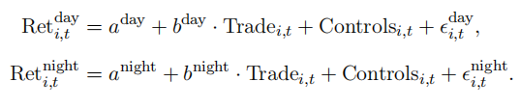
Table 4 (The Effect of Mutual Fund Trades on Intraday and Overnight Returns.)
Then we use panel regressions by the equations below to estimate the impact of contemporaneous mutual fund trading on those returns.

Slide 21
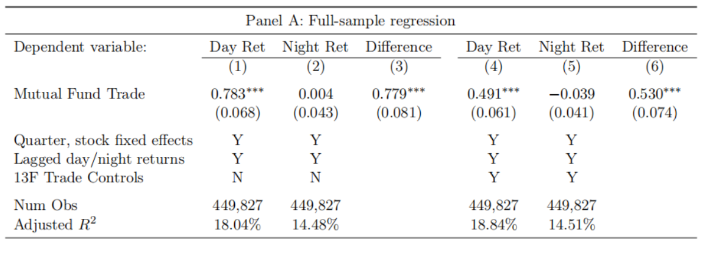
Table 4 (Original Panel A)
In the original table 4, there are two day and night return, this is because sections on the right are the control for trades by 13F institutions. Standard errors are clustered by quarter and stock.

Slide 22
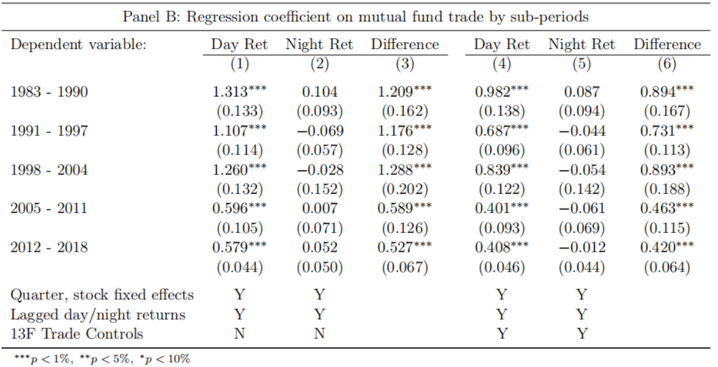
Table 4 (Original Panel B)

Slide 23
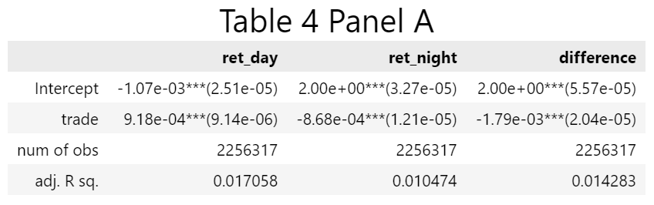
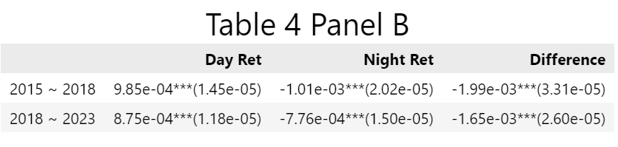
Table 4 (Our replication)

Slide 24
Table 4 (Our replication and comparison)
In our replication, we did not do the control for trades by 13F institutions, which means compared with original table above, our tables below do not have sections 4, 5 and 6 in both panel A and panel B. Again, even we have larger number of observations, our mutual fund trade and adjusted R square is lower than the original table. Both the day return and net return in our analysis show poorer performance than the original table.

Slide 25
Figure 4. Flow-induced Demand in Size and Value Factors.
Apart from the tables, we also replicate some figures to keep on proving our idea. We chose the Flow-induced Demand in Size and Value Factors to investigate whether the flow-induced demand in factors in value and profitability are highly correlated with factor returns in China A-share market.

Slide 26
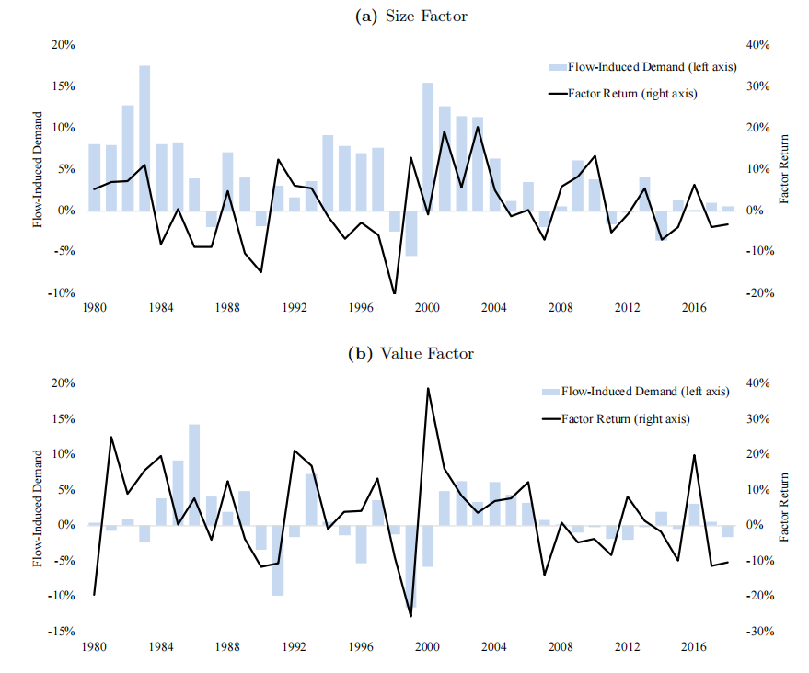
Figure 4. (Original)
Flow induced demand in size factor and value factor

Slide 27
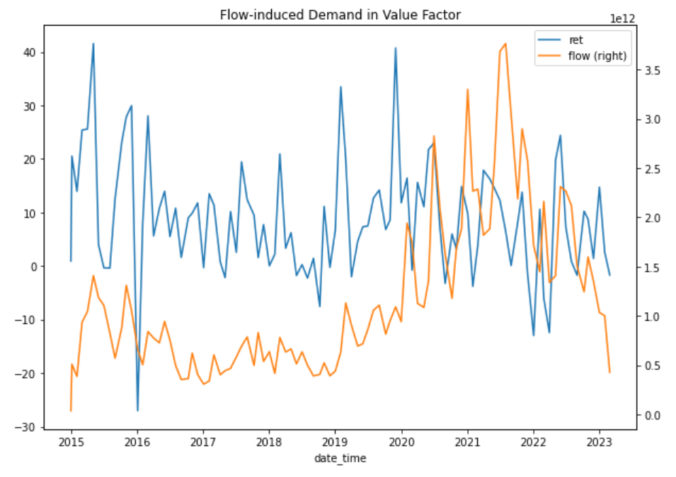
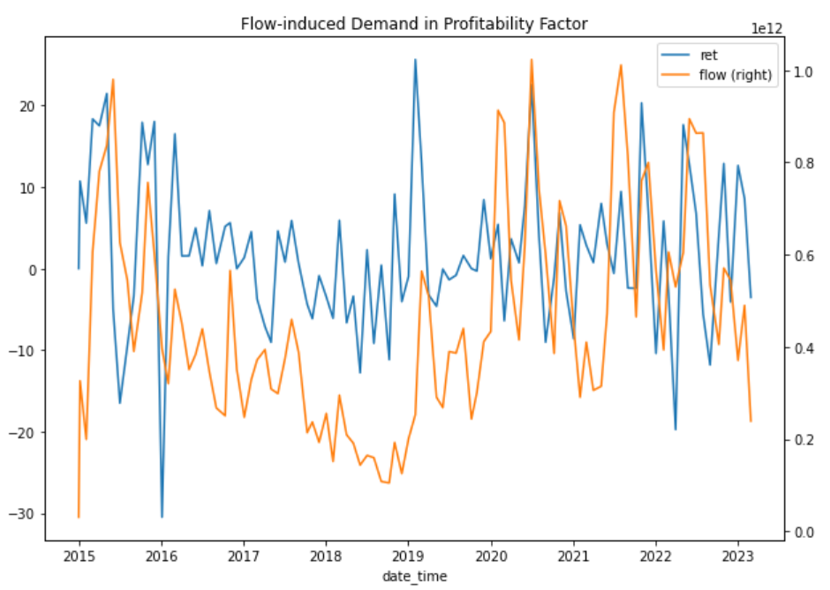
Figure 4 (Our replication)
As shown in our replication, both the value factor and the profitability factor are not correlated with the return. This shows that during these years China A-share is different from US market.

Slide 28
Our extension in hedging
THREE
3

Slide 29
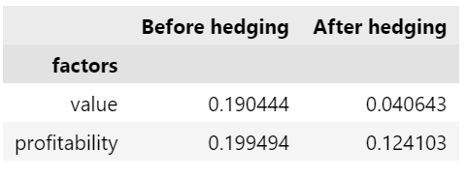
Extension
Apart from the replication of the original tables, we also try to construct the investment portfolio with the most optimize risk and highest return by combining the flow-value factors or the flow-profitability factors and select the highest bin of each indicator.
The performance before and after hedging for both factors are shown below:

Slide 30
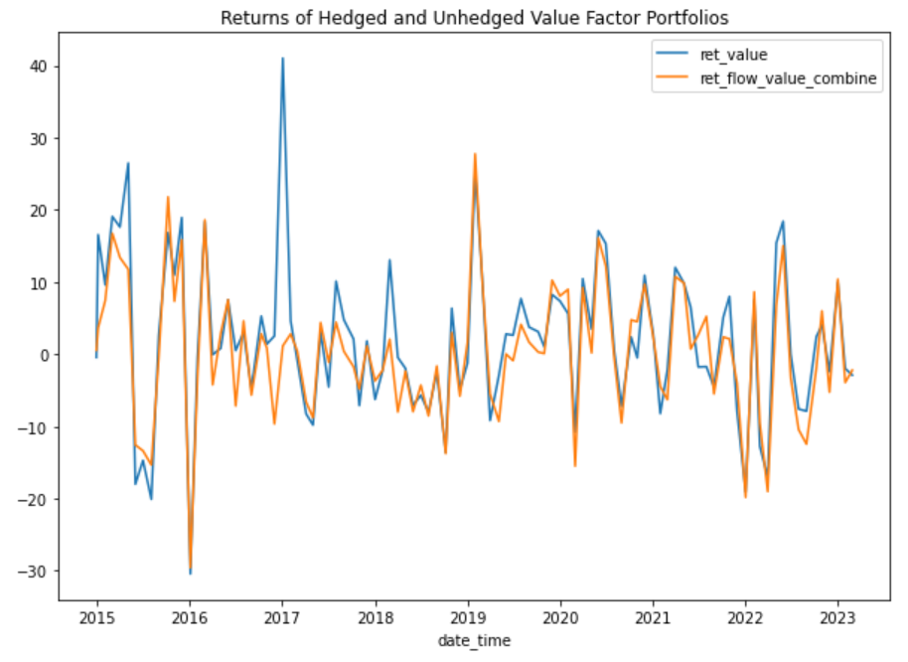
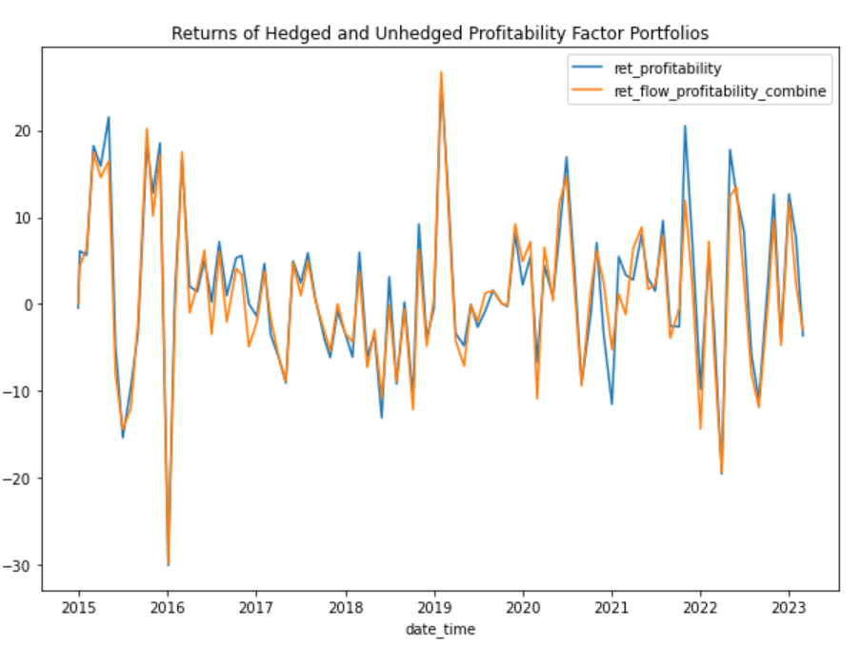
Two figures

Slide 31
Conclusion
FOUR
4

Slide 32
Conclusion
The correlation between profitability and flow factor is weak as well as the correlation between value and flow factor. Therefore we shall not use profitability factor or the value factor to trade or hedge.
What’s more, the idea in the article which is applicable for US stock market is not suitable for the China A-share market in recent years.

Slide 33
THANKS

